Slide 1
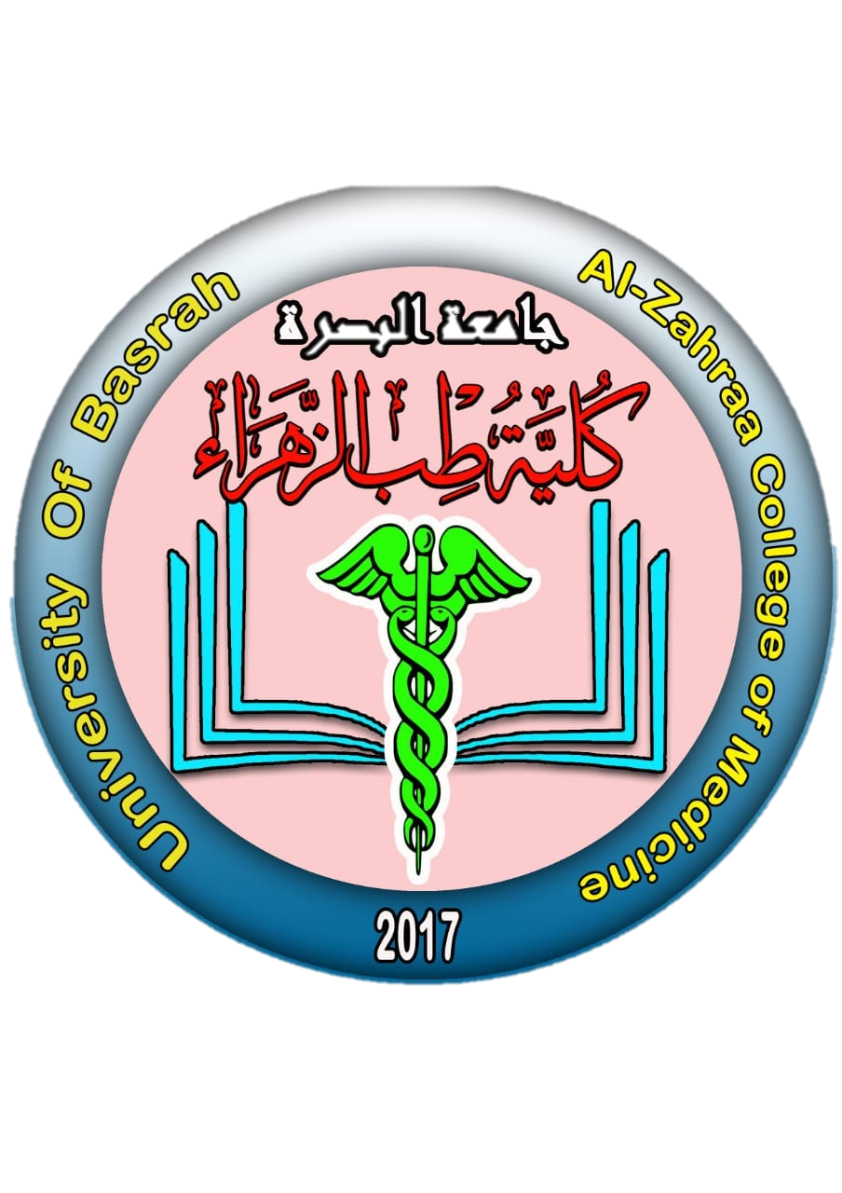
University of Basrah
AL-Zahraa College of Medicine
Ministry of higher Education and Scientific Research
Cardiorespiratory Care Block
Lecture title:
Date:
Dr.
CRC Block Staff:
Dr Firas Rashid Sayil (block leader)
Dr. Mohammed Adil
Dr Assad Hassan
Dr Ahmed Qassim
Dr Safa Asaad
Dr Mustafa Ghazi
Dr Ilham Mohammed
Dr Zainab Muzahim
Dr. Ahmed Bader
Dr Nawal Mustafa
Dr Zainab Almnaseer
Dr Farqad Alhamdani
Dr Ban M. Saleh
Dr Amani Namaa
References as in the workbook and classroom.
For more detailed instruction, any question, cases need help please contact block leader at the CRC Google classroom or email.

Slide 2
University of Basra
AL-Zahraa College of Medicine
Ministry of higher Education and Scientific Research
Learning objective:
Knowing the main pathology effecting the cardiac valve.
Understanding the different clinical presentation of valvular heart disease
Knownig the main cause for the development of valvular heart disease.

Slide 3
University of Basra
AL-Zahraa College of Medicine
Ministry of higher Education and Scientific Research
Mitral valve disease:
Mitral stenosis
Mitral stenosis is almost always rheumatic in origin, although in older people it can be caused by heavy calcification of the mitral valve. There is also a rare form of congenital mitral stenosis.
In rheumatic mitral stenosis, the mitral valve orifice is slowly diminished by progressive fibrosis, calcification of the valve leaflets, and fusion of the cusps and subvalvular apparatus.
The mitral valve orifice is normally about 5 cm2 in diastole but can be reduced to < 1 cm2 in severe mitral stenosis. The patient is usually asymptomatic until the orifice is < 2 cm2.

Slide 4
University of Basra
AL-Zahraa College of Medicine
Ministry of higher Education and Scientific Research
As stenosis progresses, left ventricular filling becomes more dependent on left atrial contraction. There is dilatation and hypertrophy of the LA and left atrial pressure rises, leading to pulmonary venous congestion and breathlessness.
Atrial fibrillation is very common due to progressive dilatation of the LA. Its onset often precipitates pulmonary oedema because the accompanying tachycardia and loss of atrial contraction lead to marked haemodynamic deterioration and a rapid rise in left atrial pressure
In the absence of AF, a more gradual rise in left atrial pressure may occur. In the presence or absence of AF, pulmonary hypertension may occur, which can protect the patient from pulmonary oedema.

Slide 5
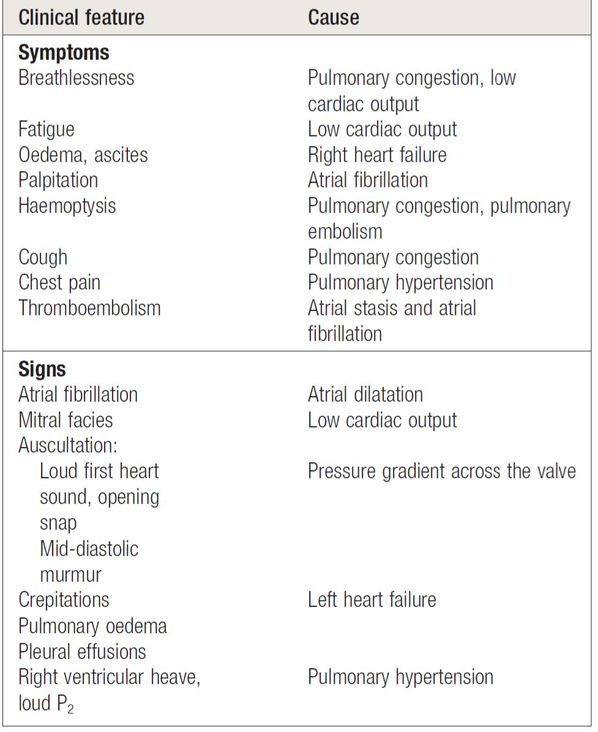
University of Basra
AL-Zahraa College of Medicine
Ministry of higher Education and Scientific Research
Clinical features:

Slide 6
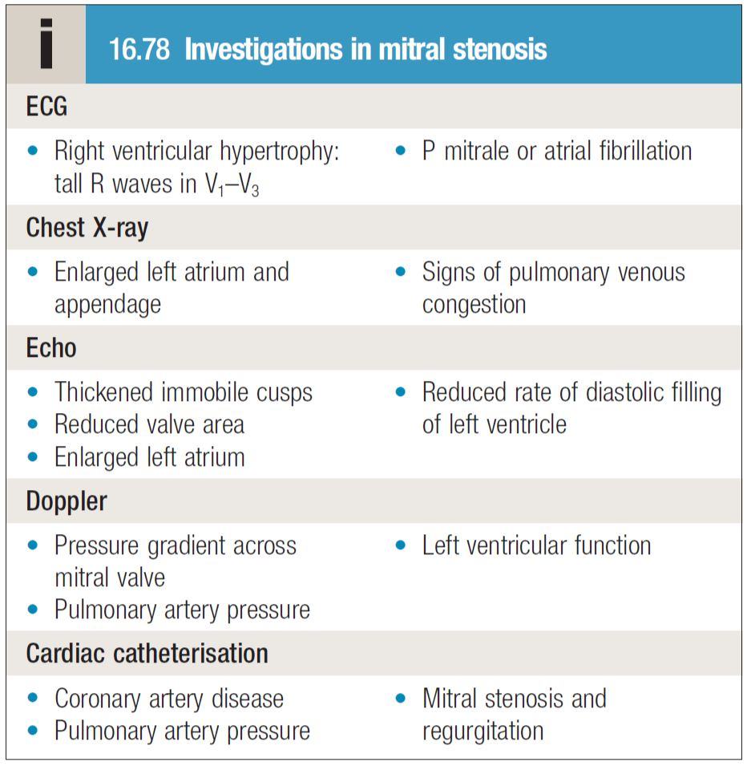
University of Basra
AL-Zahraa College of Medicine
Ministry of higher Education and Scientific Research
Investigations

Slide 7
University of Basra
AL-Zahraa College of Medicine
Ministry of higher Education and Scientific Research
Management
Patients with mild symptoms can be treated medically but intervention by balloon valvuloplasty, mitral valvotomy or mitral valve replacement should be considered if the patient remains symptomatic despite medical treatment or if pulmonary hypertension develops.
Medical management
This consists of anticoagulation to reduce the risk of systemic embolism, ventricular rate control with digoxin, β-blockers or rate-limiting calcium antagonists in AF, and diuretic to control pulmonary congestion. Antibiotic prophylaxis against infective endocarditis is no longer routinely recommended.

Slide 8
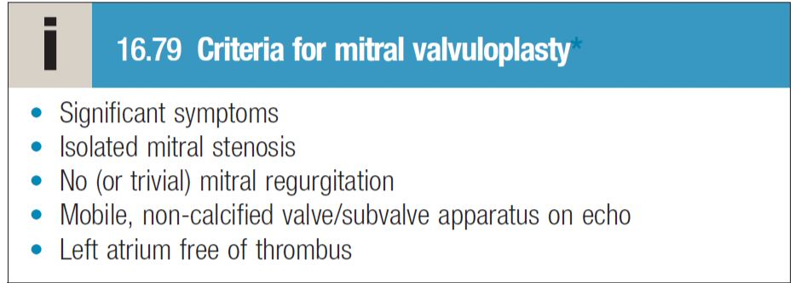
University of Basra
AL-Zahraa College of Medicine
Ministry of higher Education and Scientific Research
Mitral balloon valvuloplasty and valve replacement

Slide 9
University of Basra
AL-Zahraa College of Medicine
Ministry of higher Education and Scientific Research
Mitral regurgitation
Rheumatic disease is the principal cause in countries where rheumatic fever is common but elsewhere, including in the UK, other causes are more important Mitral regurgitation may also follow mitral valvotomy or valvuloplasty.

Slide 10
University of Basra
AL-Zahraa College of Medicine
Ministry of higher Education and Scientific Research
Mitral valve prolapse
This is also known as ‘floppy’ mitral valve and is a common
cause of mild mitral regurgitation .Some cases are
thought to be due to a developmental abnormality of the mitral
valve and others due to degenerative myxomatous change in a
normal mitral valve. Rarely, mitral valve prolapse may occur in
association with Marfan’s syndrome.
Mitral valve prolapse is associated with a variety of typically
benign arrhythmias, atypical chest pain and a very small risk of
embolic stroke or transient ischaemic attack (TIA). Nevertheless,
the overall long-term prognosis is good.

Slide 11
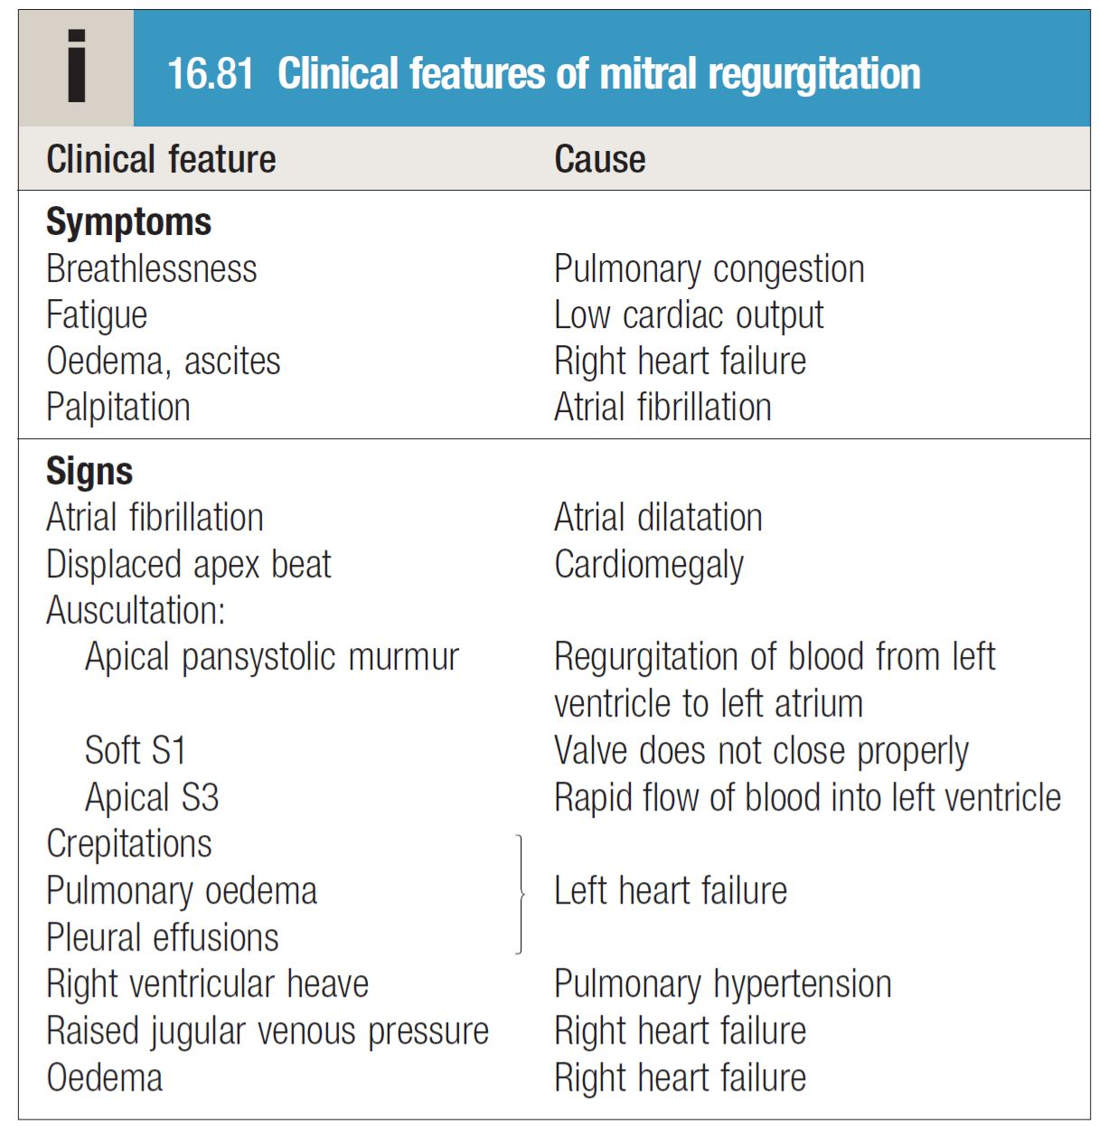
University of Basra
AL-Zahraa College of Medicine
Ministry of higher Education and Scientific Research
Clinical features

Slide 12
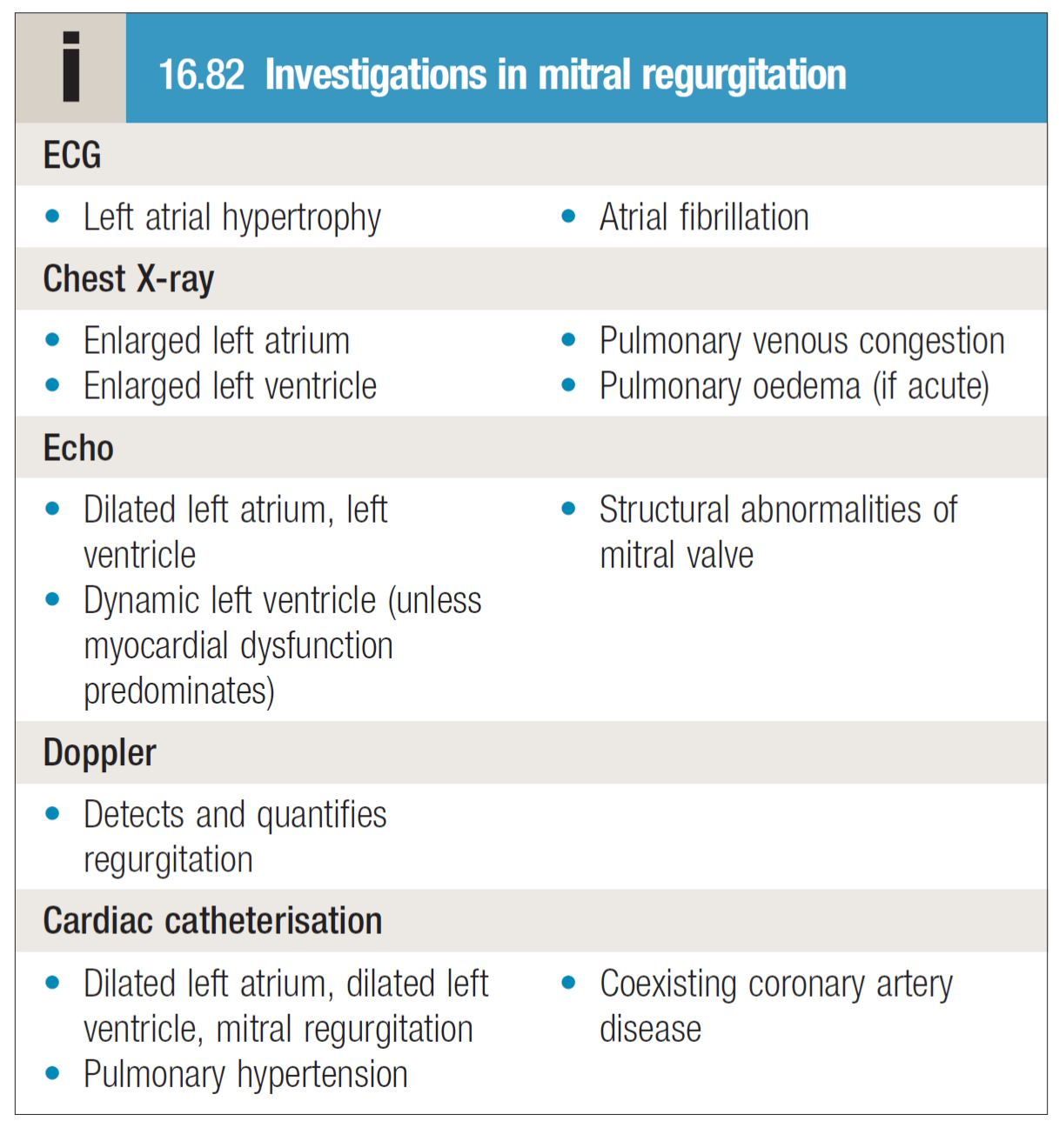
University of Basra
AL-Zahraa College of Medicine
Ministry of higher Education and Scientific Research
Investigations

Slide 13
University of Basra
AL-Zahraa College of Medicine
Ministry of higher Education and Scientific Research
Management
Medical management
What are the indication of surgery in MS and MR?

Slide 14
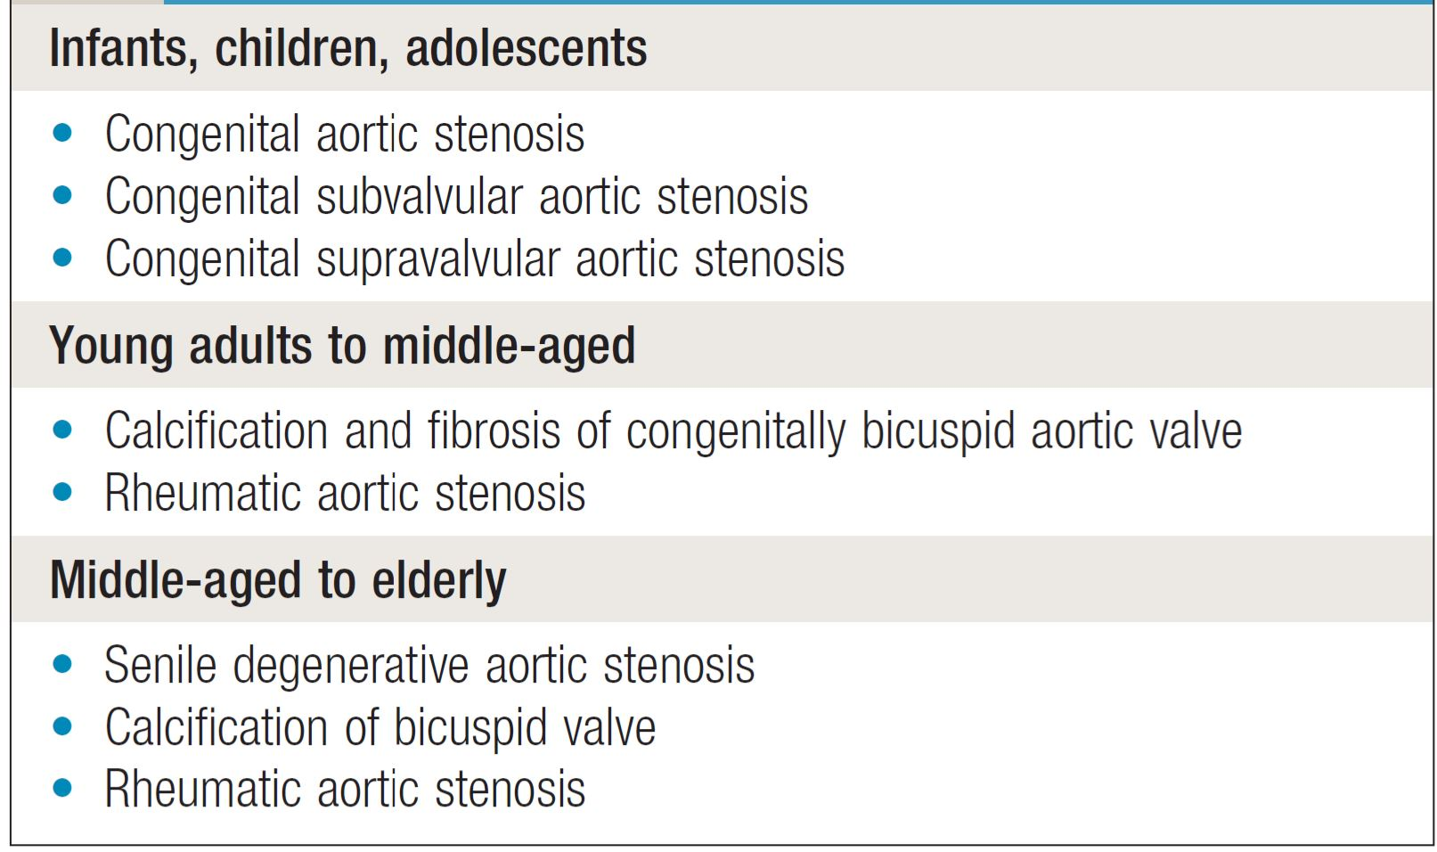
University of Basra
AL-Zahraa College of Medicine
Ministry of higher Education and Scientific Research
Aortic valve disease
Aortic stenosis

Slide 15
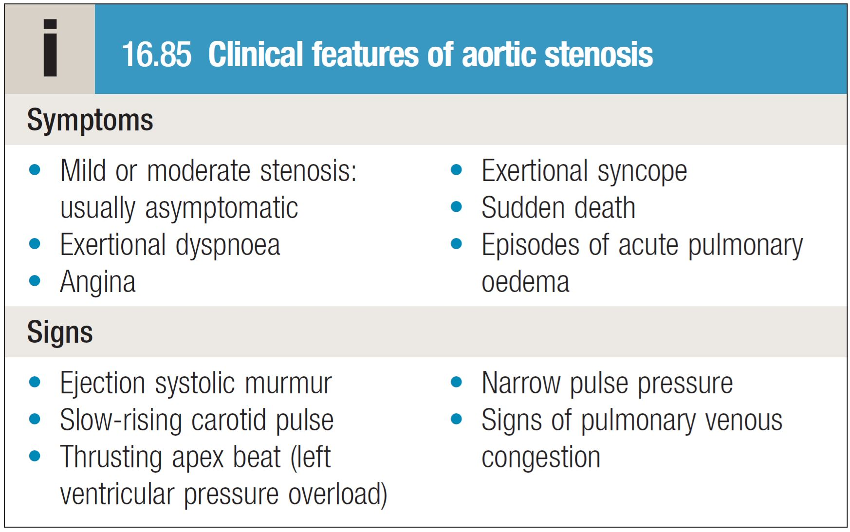
University of Basra
AL-Zahraa College of Medicine
Ministry of higher Education and Scientific Research
Clinical features

Slide 16
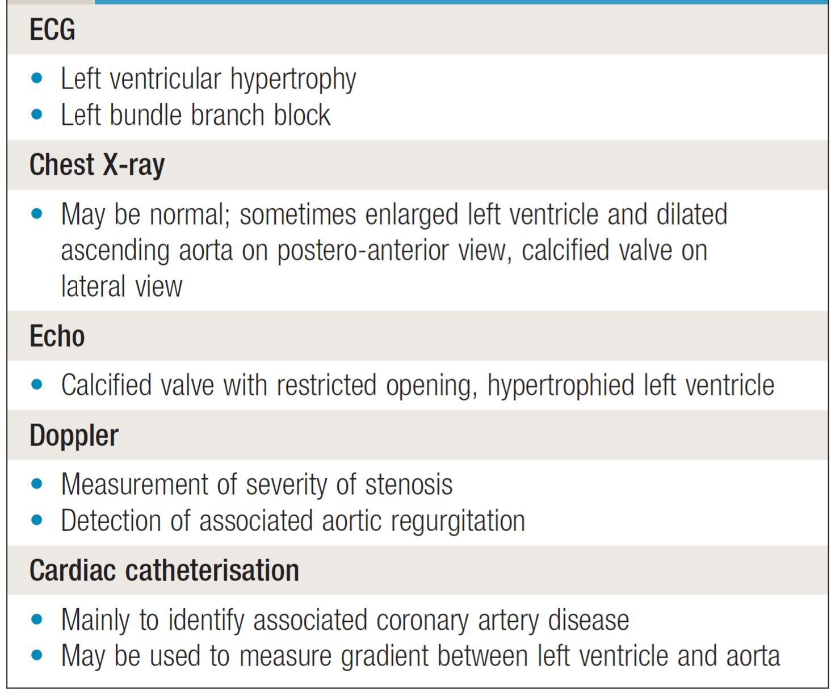
University of Basra
AL-Zahraa College of Medicine
Ministry of higher Education and Scientific Research
Investigations

Slide 17
University of Basra
AL-Zahraa College of Medicine
Ministry of higher Education and Scientific Research
Management
Which drug is contra indicated in patient with AS?
What are the indication of surgery in AS?

Slide 18
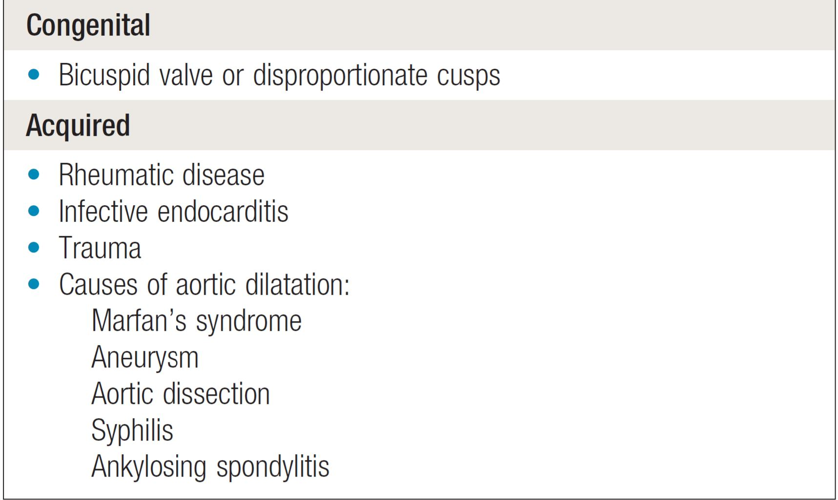
University of Basra
AL-Zahraa College of Medicine
Ministry of higher Education and Scientific Research
Aortic regurgitation
This condition can result from either disease of the aortic valve
cusps, infection, trauma or dilatation of the aortic root.

Slide 19
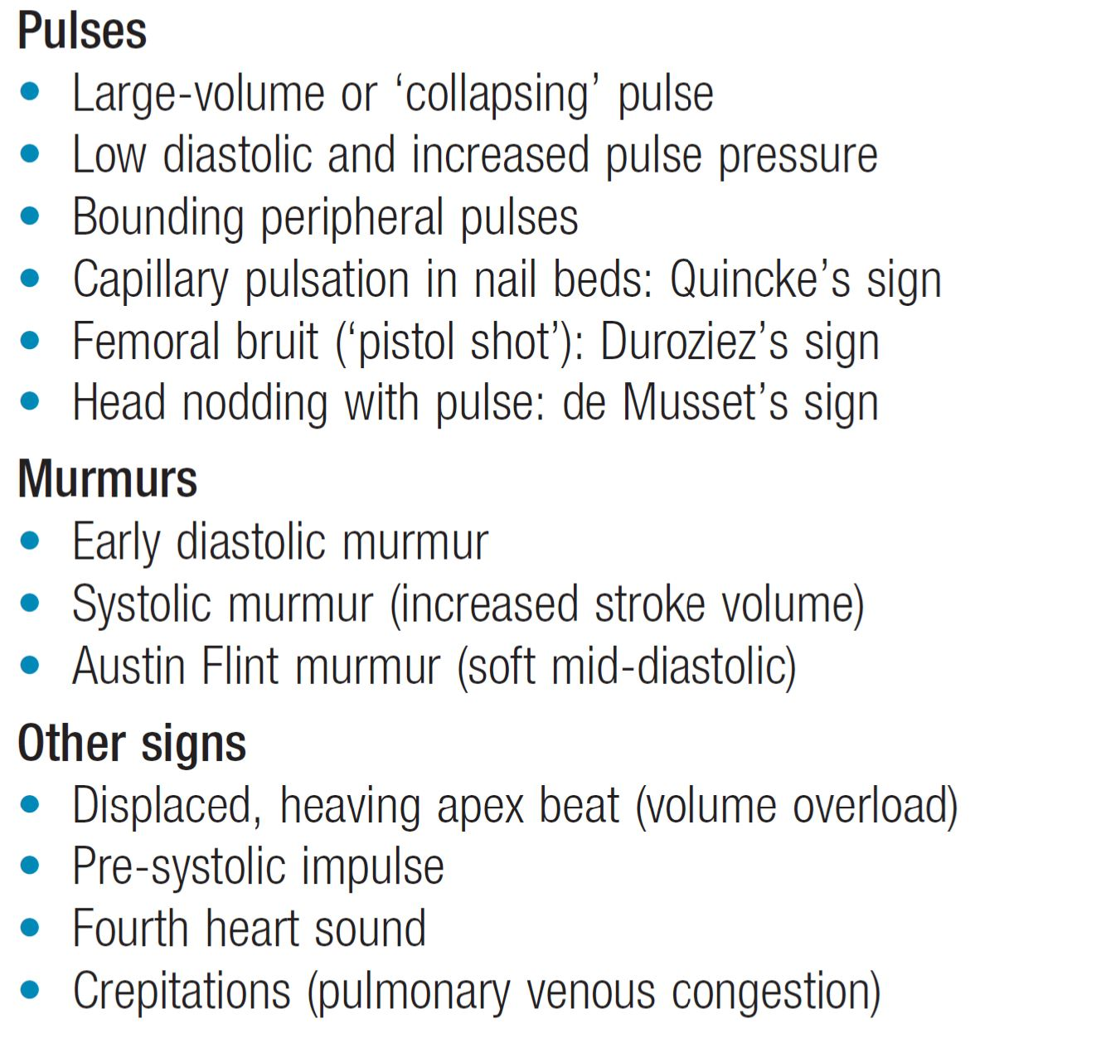
University of Basra
AL-Zahraa College of Medicine
Ministry of higher Education and Scientific Research
Clinical features

Slide 20
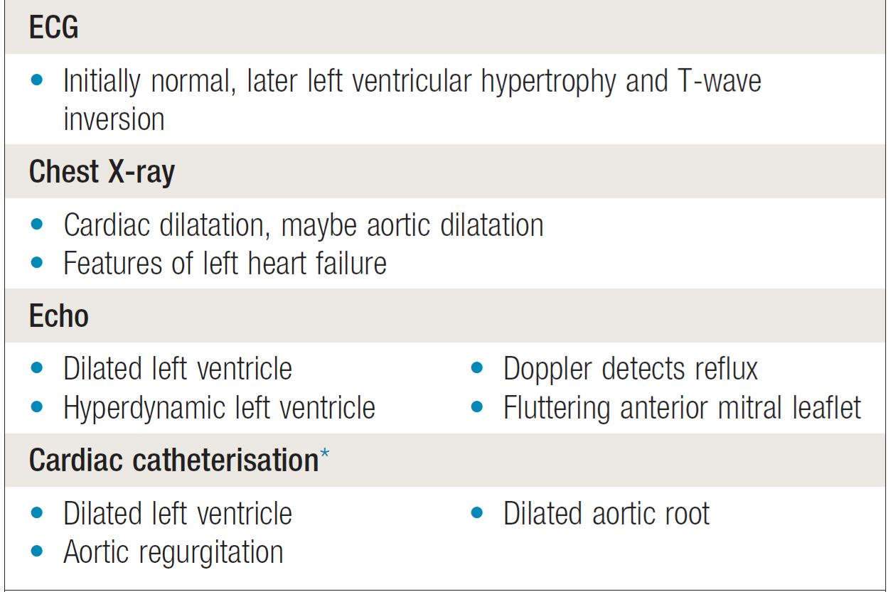
University of Basra
AL-Zahraa College of Medicine
Ministry of higher Education and Scientific Research

Slide 21
University of Basra
AL-Zahraa College of Medicine
Ministry of higher Education and Scientific Research
Management
Medical and surgical ??

Slide 22
University of Basra
AL-Zahraa College of Medicine
Ministry of higher Education and Scientific Research
Thank you

